Slide 1
BA_Coursework
File created on: 27/2/22 오후 9:54:01 GMT+09:00

Slide 2
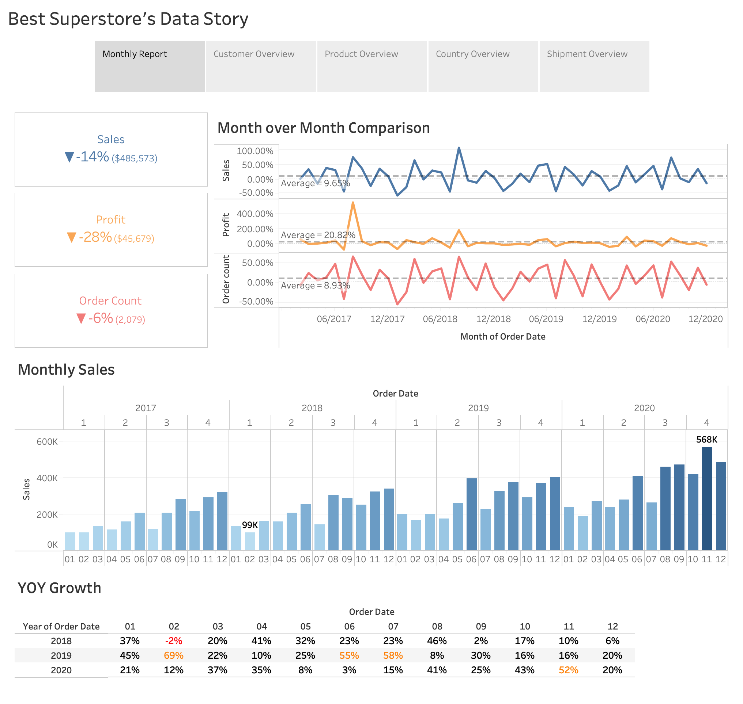

Slide 3
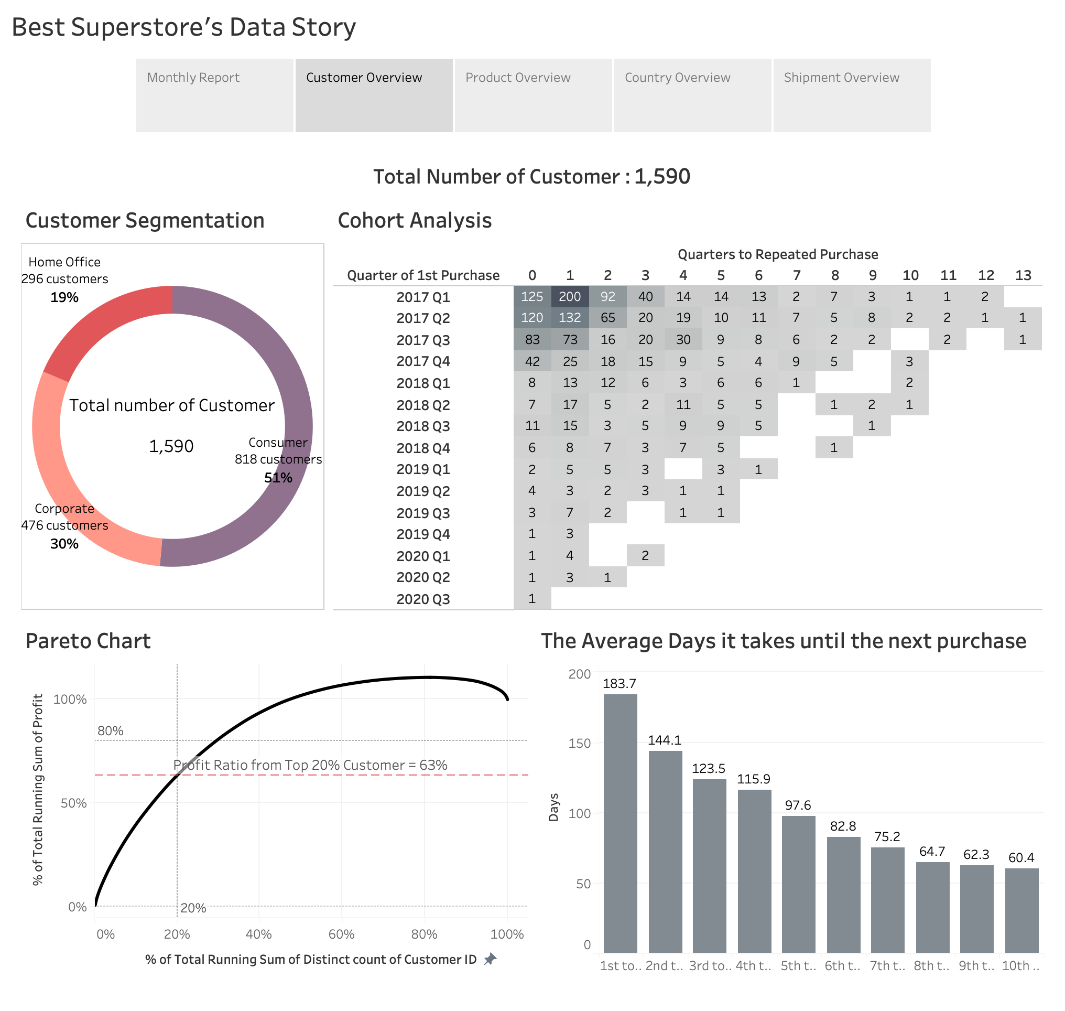

Slide 4
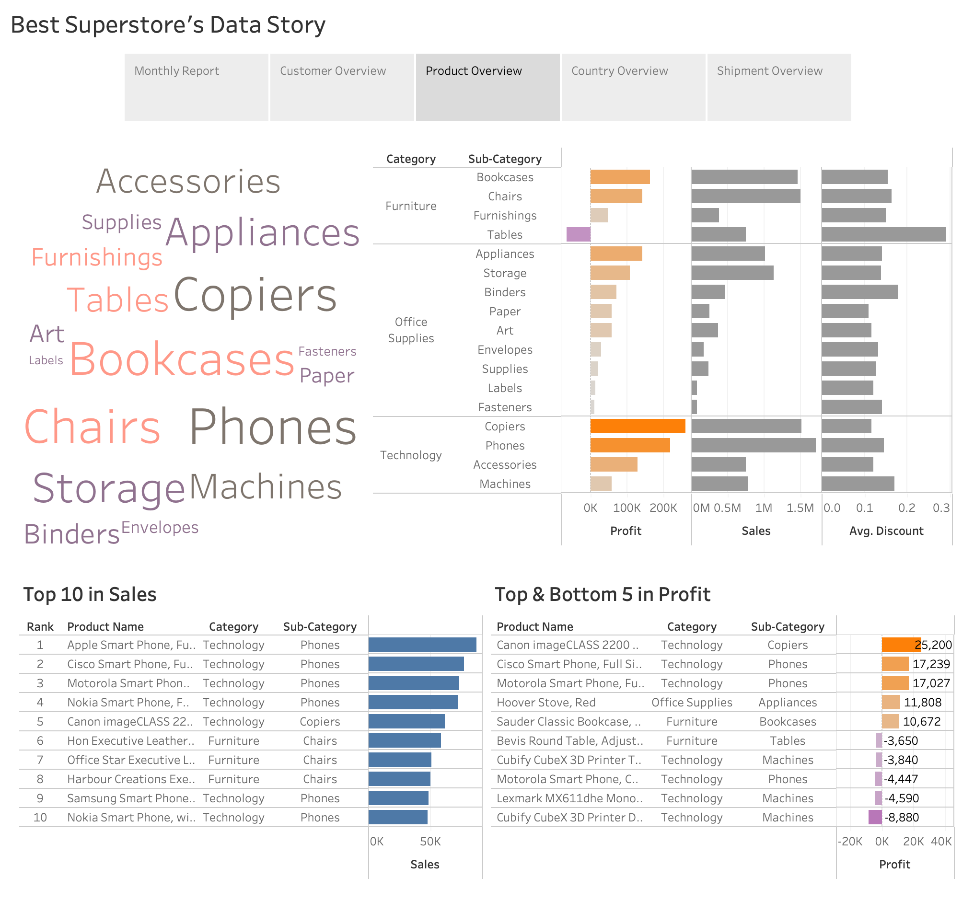

Slide 5
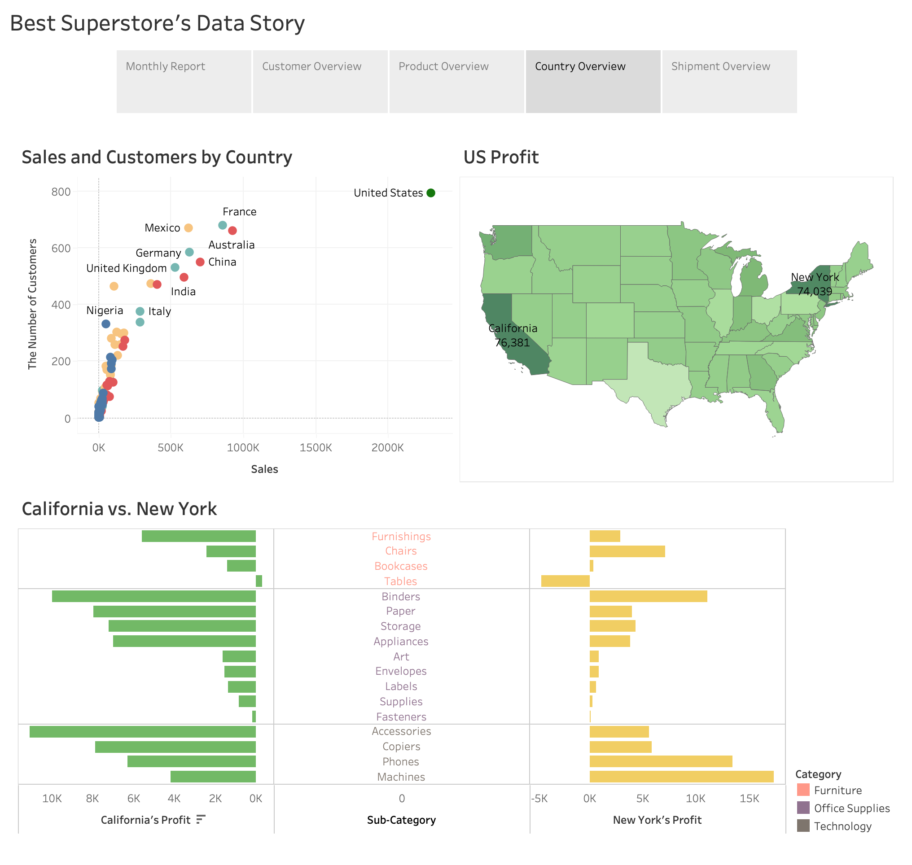

Slide 6
